Slide 1
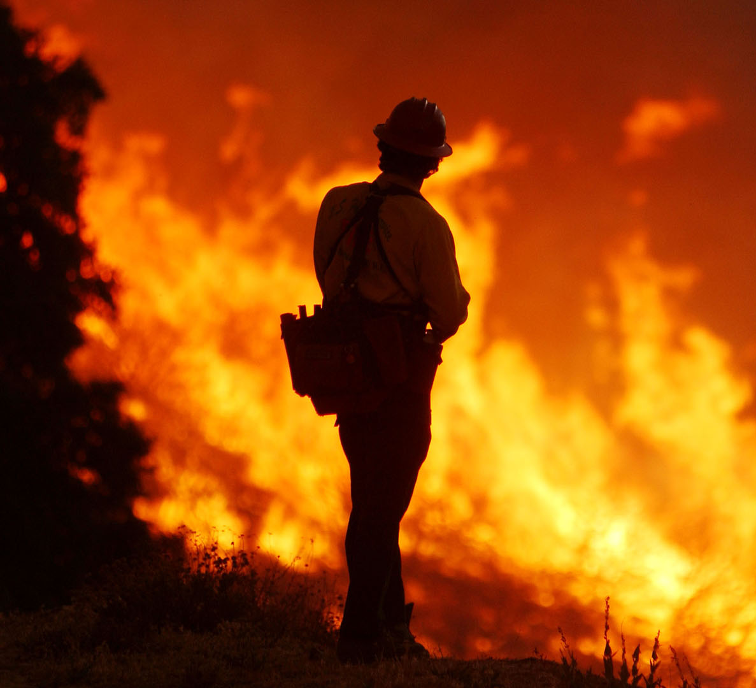
ANLY501 Final project Group 7 Feiyang Jiang Michael McCauley Xuejun Zhang
U.S. Wildfire Causation and Prediction Analysis

Slide 2
Agenda
Problem Definition
Models Fitting and Selection
Data Wrangling
EDA Insights
Future Work
Model Implementation
Q&A

Slide 3

Problem definition
Detect wildfire causes Expedite the wildfire containing process
U.S. forest
service firefighter
Check historical wildfire causation with missing causation values
U.S. forest
service officers
Insurance companies agents
Check the potential causation of the wildfire and choose the right compensation plan

Slide 4
Data Wrangling
Original Dataset - U.S. wildfire records from 1992 to 2015(759 MB)
Extract columns on fire causes and potential related factors for 3 states - CA, CO, TX
Delete rows with missing and incorrect values
Notes:
1,000,000 + data points
25+ variables

Slide 5
Data Wrangling
Data formatting on time variables and change categorical values to numerical values
Aggregate data with historical weather data (temperature, wind speed)
Preprocessed data 67373 data entries with 17 columns
Notes:
1,000,000 + data points
25+ variables

Slide 6
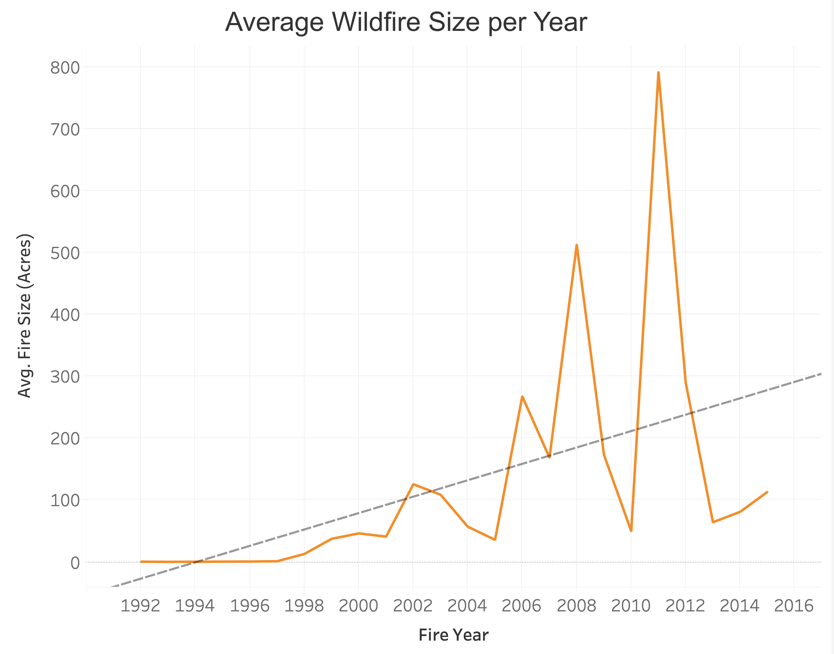
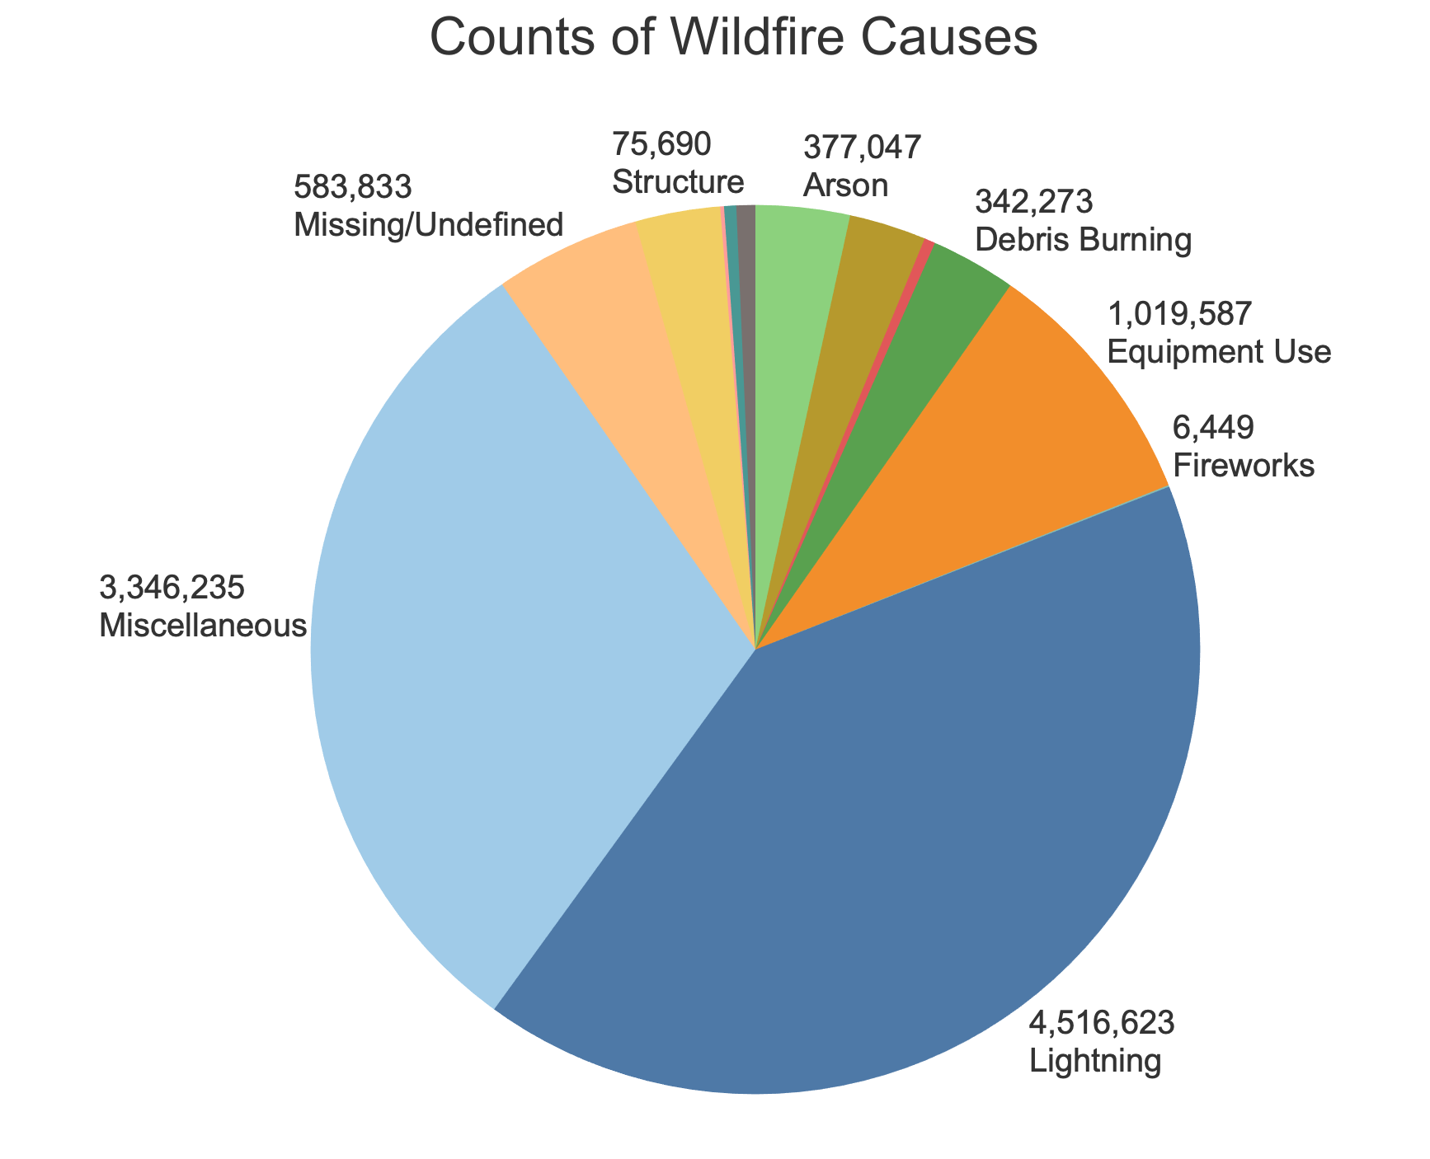
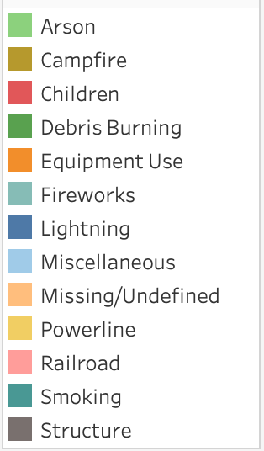
EDA Insights
Notes:
1,000,000 + data points
25+ variables

Slide 7
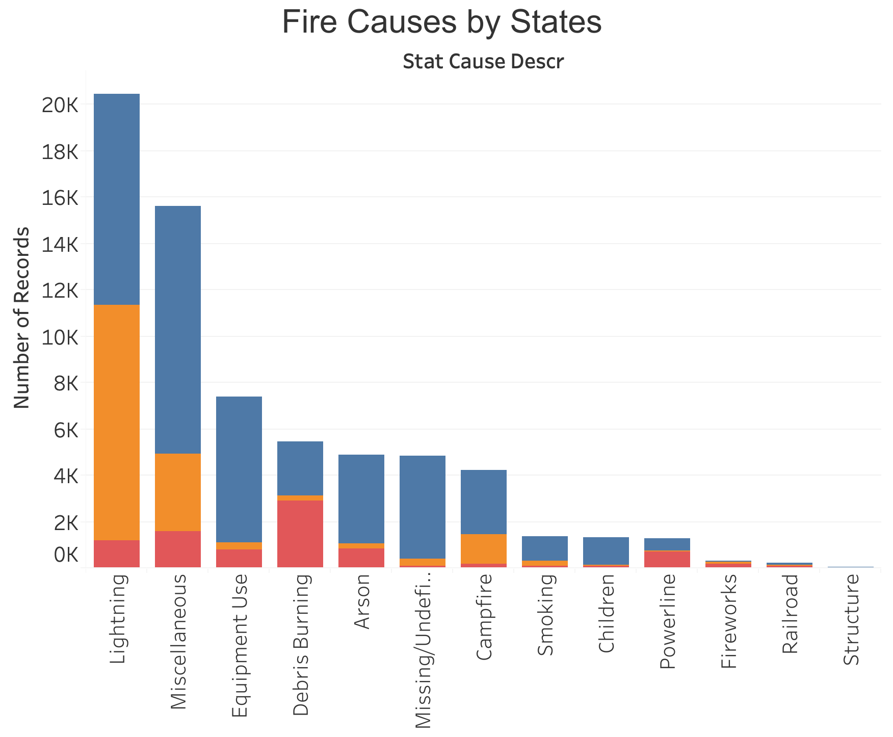
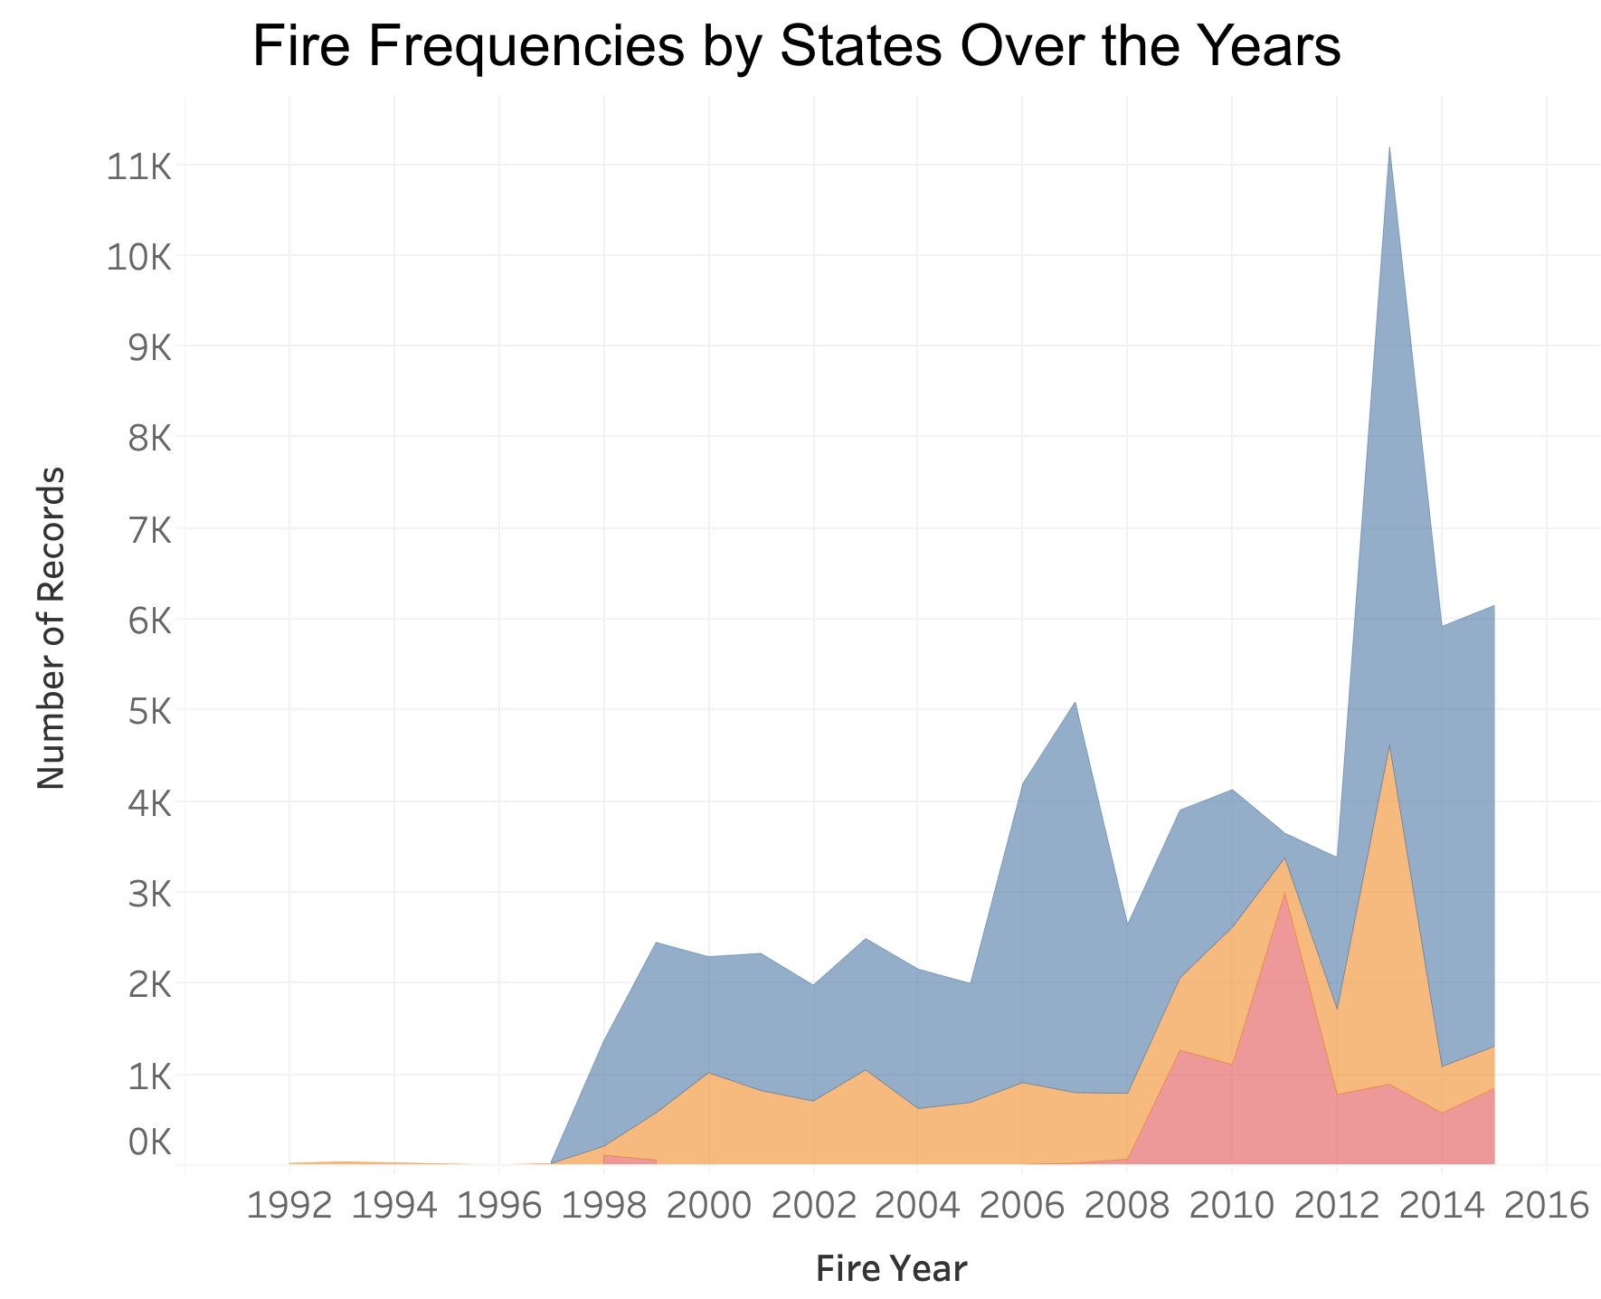
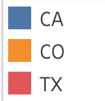
EDA Insights
Notes:
1,000,000 + data points
25+ variables

Slide 8
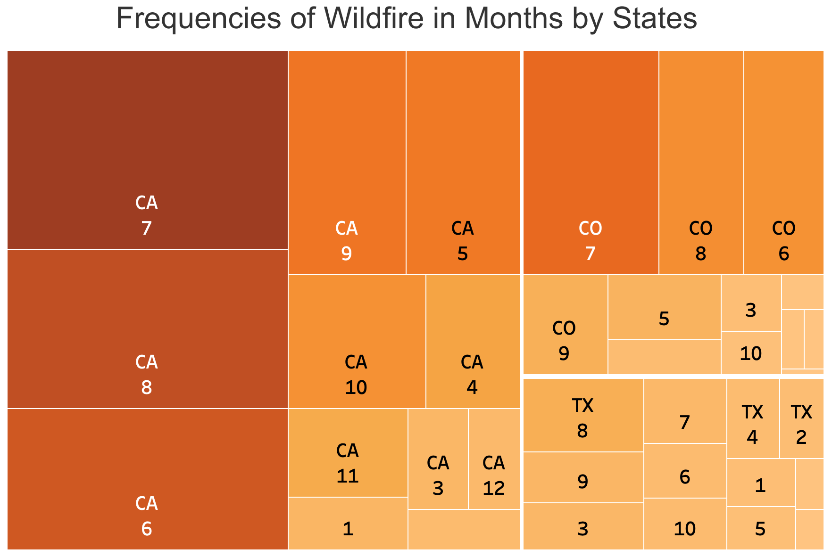
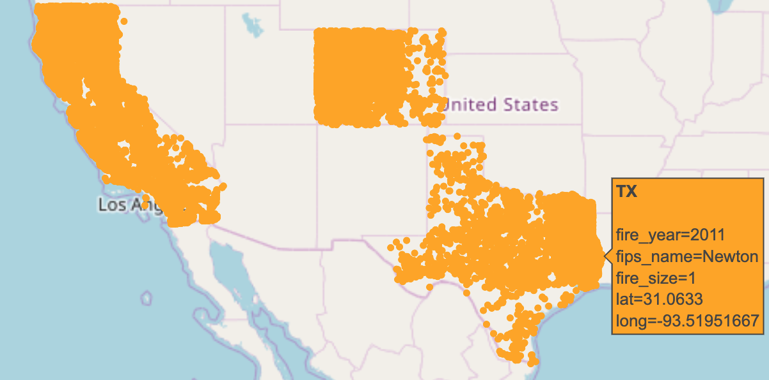
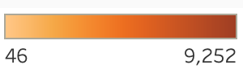
EDA Insights
Frequencies of Wildfire in Months by States
Scatter Plot of Longitudes and Latitudes
Notes:
1,000,000 + data points
25+ variables

Slide 9
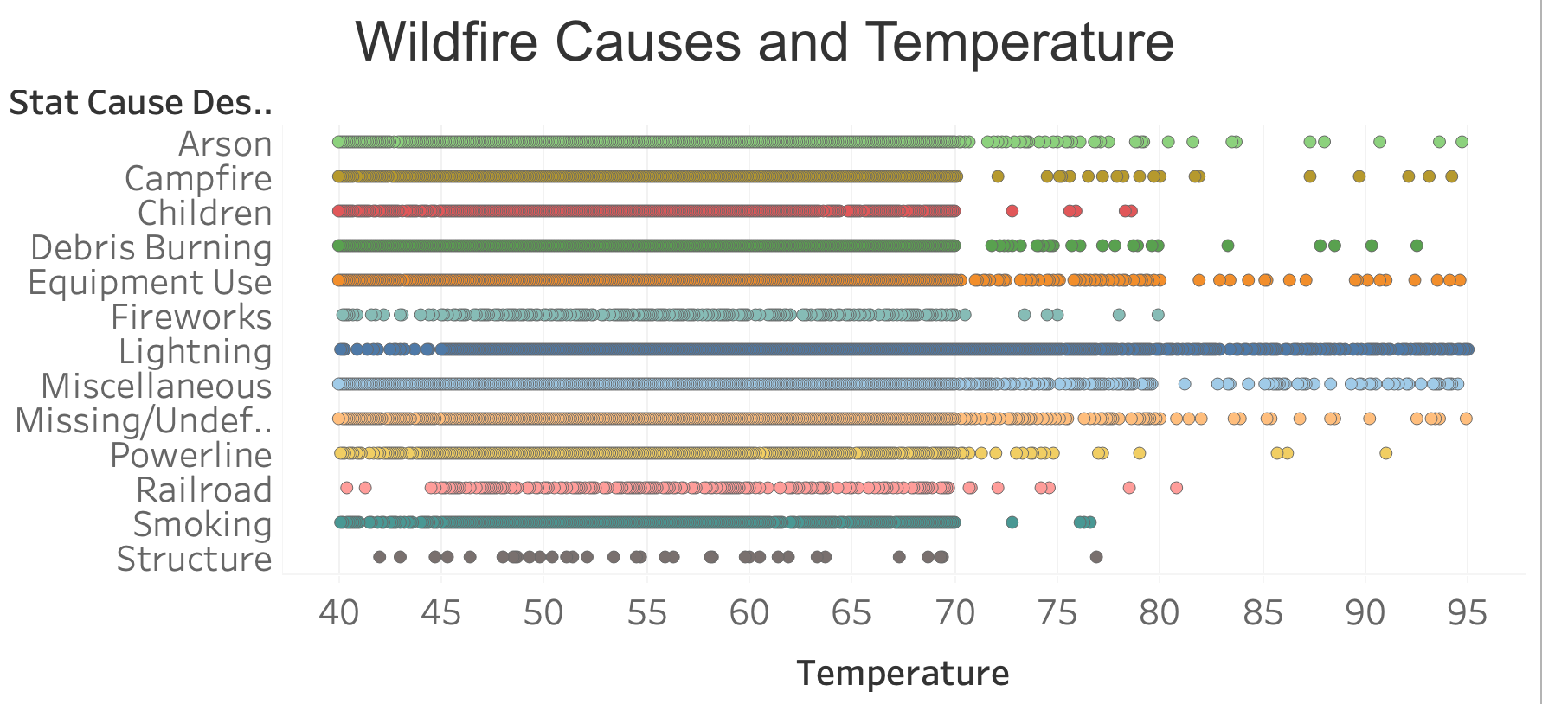
EDA Insights
Notes:
1,000,000 + data points
25+ variables

Slide 10
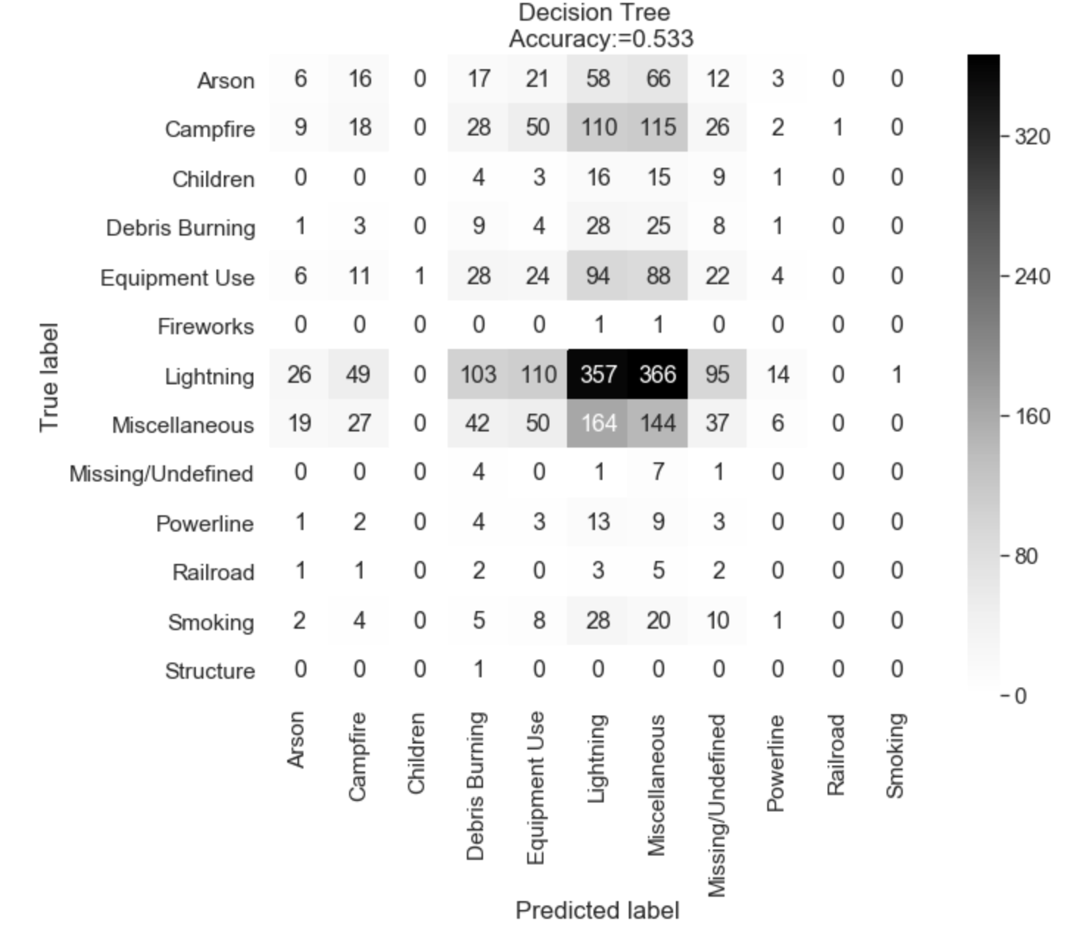
Models Fitting
Accuracy = 0.533
Precision = TP / (TP+FP)
= 0.31908
Recall = TP / (TP+FN)
= 0.49846
Highest recall, 2nd highest accuracy and precision

Slide 11
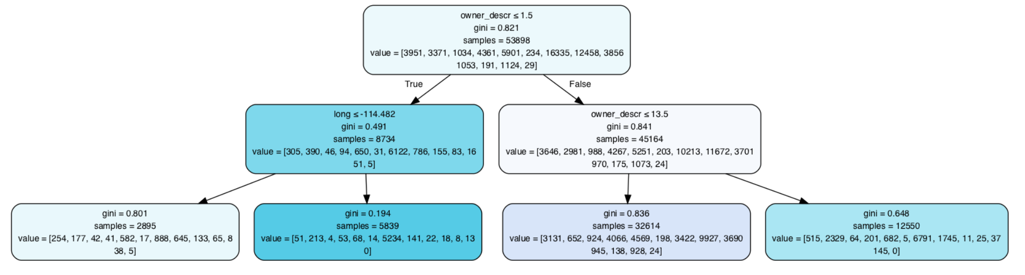
Models Fitting
Classification Tree with Max depth = 2

Slide 12
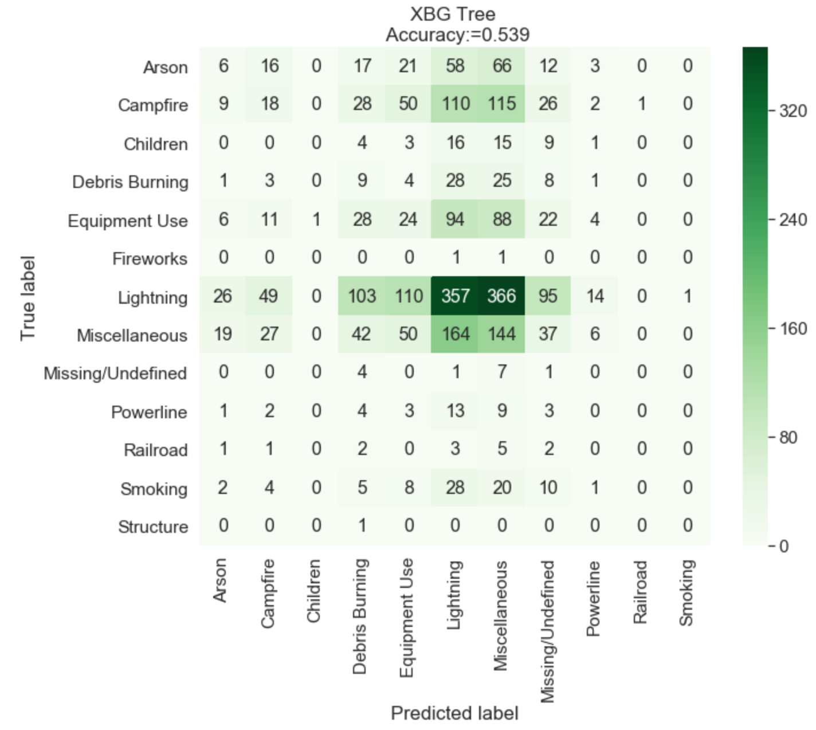
Models Fitting
Accuracy = 0.539
Precision = TP / (TP+FP)
= 0.394
Recall = TP / (TP+FN)
= 0.267
Lowest recall, lowest precision

Slide 13
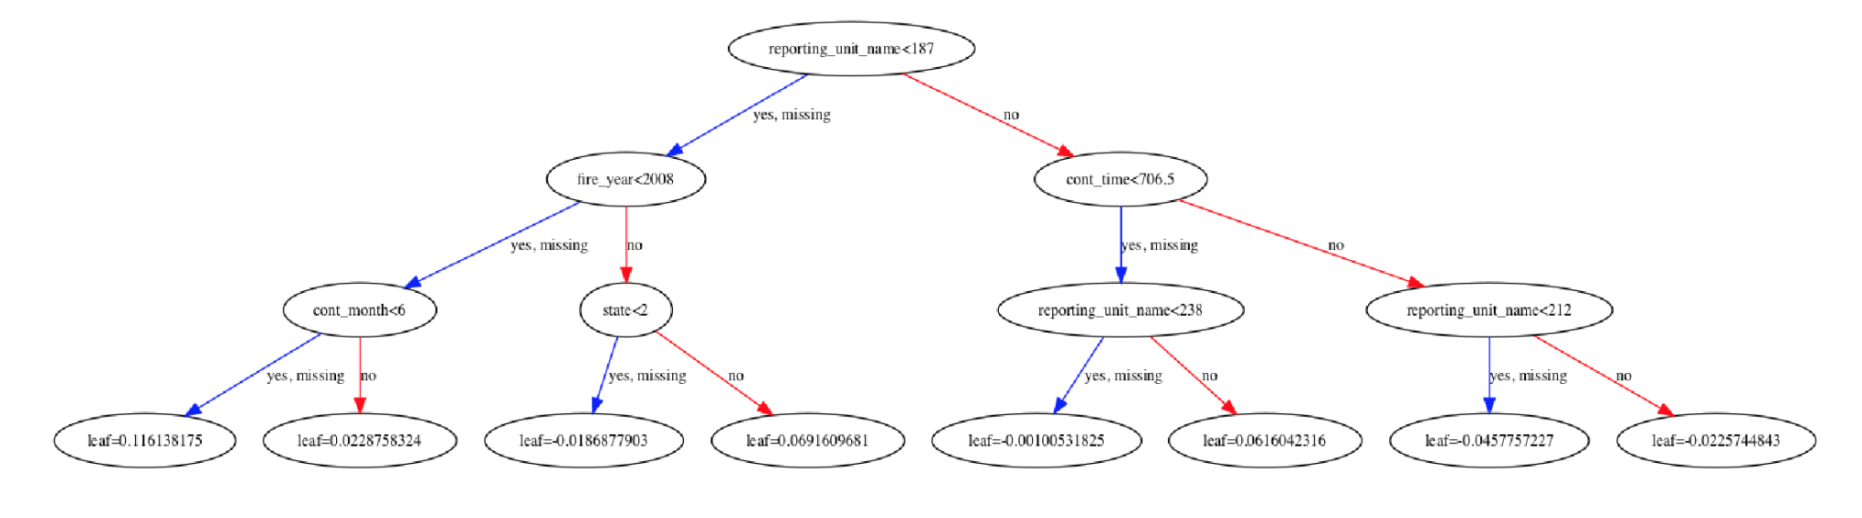
Models Fitting
Xgb Tree Visualization

Slide 14
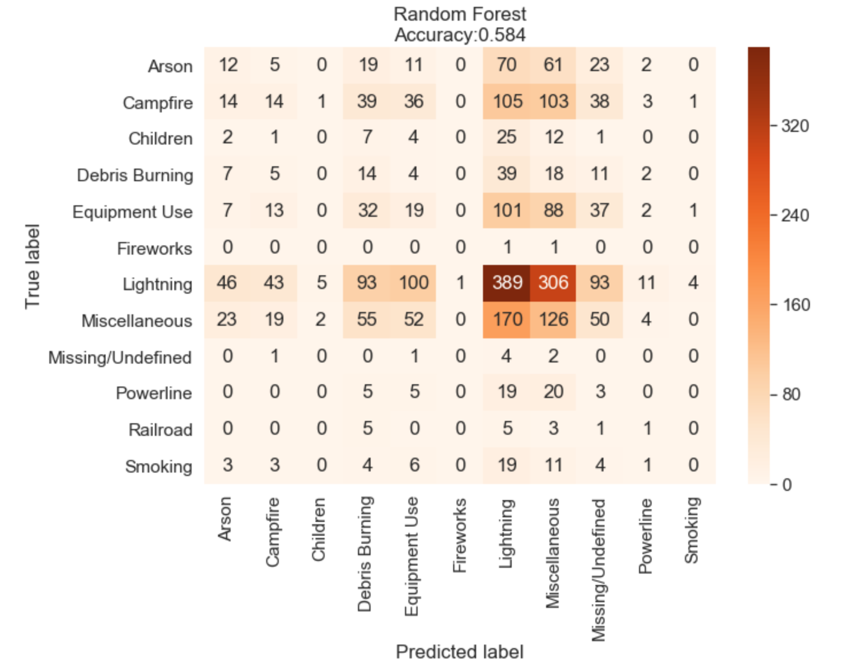
Models Fitting
Accuracy = 0.584
Precision = TP / (TP+FP)
= 0.45032
Recall = TP / (TP+FN)
= 0.31628
Highest Accuracy, highest Precision, 2nd highest Recall

Slide 15
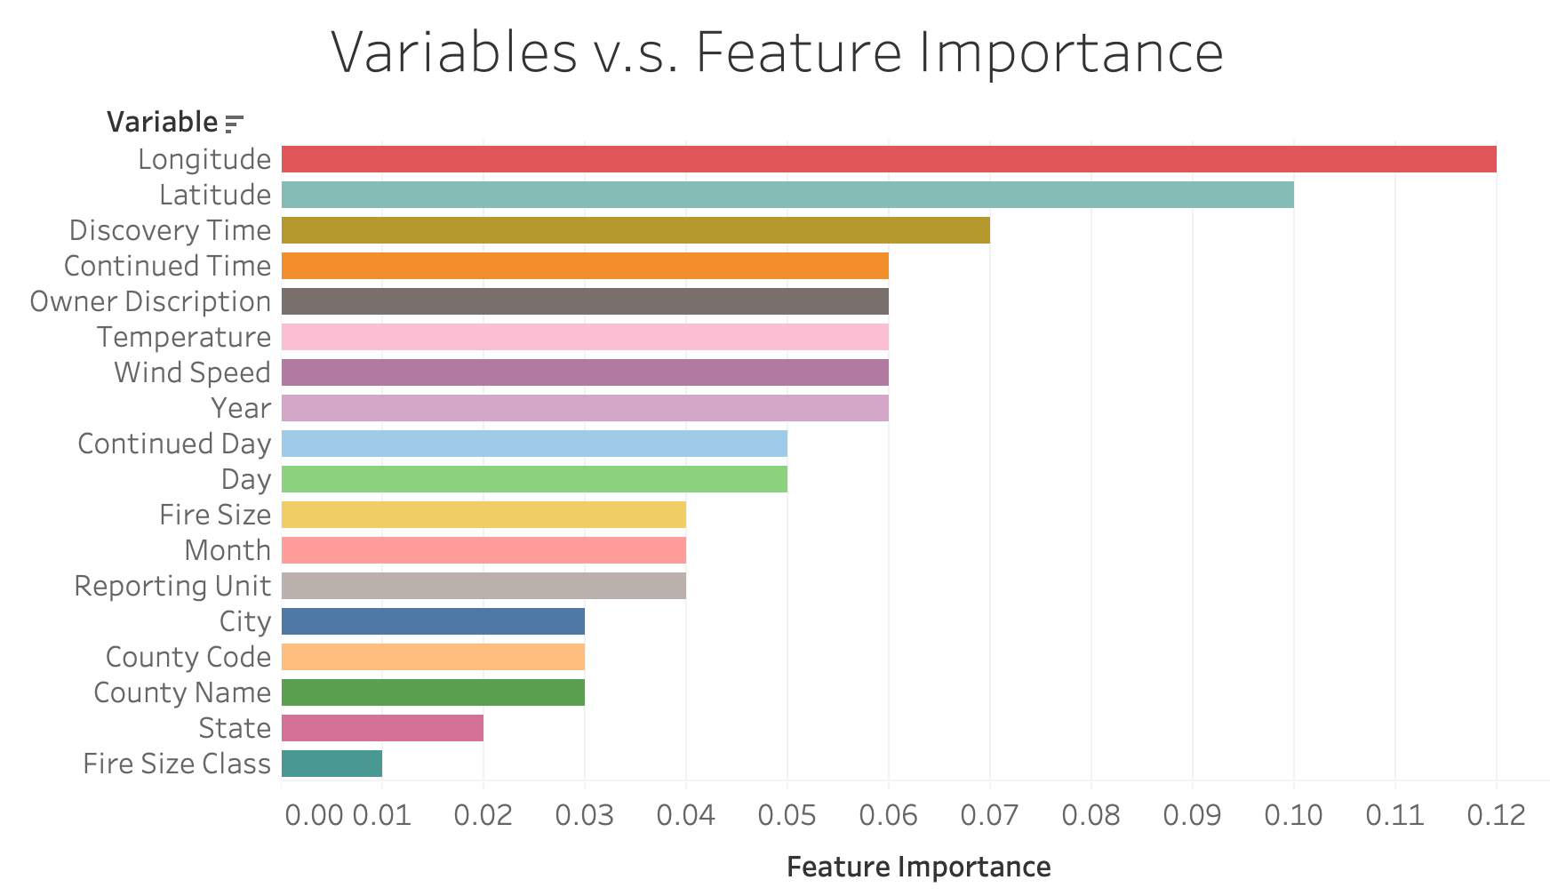
Models Fitting
Redundant variable were deleted
When firefighters try to use the model, the continued time are unknown, so the continued time variables are dropped for them

Slide 16
Models implementation
Scenario for firefighter
Feras is a firefighter captain in Archuleta, Colorado.
Just now, he received the wildfire alarm on forest unit ﻿Pagosa Fire protection district and he wants to detect the cause of the wildfire ahead to develop a fire extinction plan as soon as possible…

Slide 17
Models implementation
Scenario for firefighter
Variable | Parameter | Variable | Parameter
Reporting Unit Name | 194 | Latitude | 37.2695
Discovery Year | 2019 | Longitude | -107.0098
Discovery Month | 12 | State | 1
Discovery Day | 2 | City | 225
Discovery Time | 1610 | County | 7
Fire Size | 3.00 acres | Temperature | 60
Wind Speed | 8.5 mph
Predicted Fire Causation: Lightning
Notes:
City is Pagosa Springs

Slide 18
Models implementation
Scenario for U.S. Forest Service (USFS) officers
Mary is a USFS Officer in the division of the Polk, Texas.
Her daily work is to record the missing values of wildfire causation since 2015 in the whole state of Texas. Now, she needs to fulfill the causation value of a wildfire that happened on 3/13/2017 in Polk, Texas.

Slide 19
Models implementation
Scenario for U.S. Forest Service officers
Variable | Parameter | Variable | Parameter
Reporting Unit Name | 146 | Latitude | 30.931983
Discovery Year | 2017 | Longitude | -94.8351
Discovery Month | 3 | State | 2
Discovery Day | 13 | City | 73
Discovery Time | 1615 | County | 373
Fire Size | 12.82 acres | Temperature | 70
Wind Speed | 10.34 mph | Continued Month | 3
Continued Day | 13
Predicted Fire Causation: Debris Burning
Notes:
TX

Slide 20
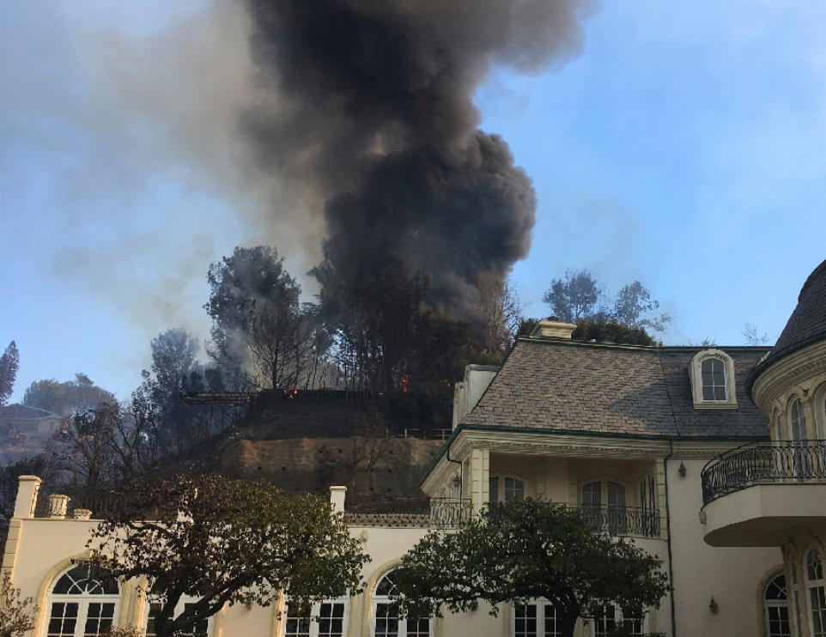
Models implementation
Scenario for Properties Insurance Company Agents
Sam is an agent in a property insurance company located in San Francisco, CA.
His company insures different house properties in central California district. Last month, a wildfire occurred in Placer county partially damaging several of his clients’ houses and he needs to evaluate the fire cause in order to proceed with the compensation.

Slide 21
Models implementation
Scenario for Properties Insurance Company Agents
Variable | Parameter | Variable | Parameter
Reporting Unit Name | 44 | Latitude | 39.138611
Discovery Year | 2019 | Longitude | -120.919683
Discovery Month | 8 | State | 0
Discovery Day | 23 | City | 100
Discovery Time | 1106 | County | 61
Fire Size | 0.1 acres | Temperature | 95
Wind Speed | 13.5 mph | Continued Month | 0
Continued Day | 3
Predicted Fire Causation: Equipment Use

Slide 22

Future work
Try other models to fit the current data points and increase the model accuracy
Collect more data to make the dataset more balance
Develop a user-interface embedded with the database and models so that users can fetch the wildfire causes predictions directly
Work on states other than California, Texas and Colorado to make the model more compatible to wildfire cases in the whole U.S.

Slide 23

Q&A
Thank you for listening!

